Slide 1
Cloud Computing

Slide 2
What is Cloud Computing?
Cloud computing is the on-demand delivery of compute power, database storage, applications and other IT resources through a cloud services platform via the Internet with pay-as-you-go pricing.
Cloud computing provides a simple way to access servers, storage, databases and a broad set of application services over the Internet.

Slide 3
6 Advantages of Cloud Computing
Trade capital expense for variable expense.
Benefit from massive economies of scale.
Stop guessing about capacity.
Increase speed and agility.
Eliminate overhead cost of maintaining data centers
Go global in minutes.

Slide 4
3 Models of Cloud Computing
Infrastructure as a Service (IaaS)
Infrastructure as a Service (IaaS) is a self-service model for managing remote data center infrastructures. Cloud vendors offers IaaS in the form of data centers.
Platform as a Service (PaaS)
Platform as a Service (PaaS) allows organizations to build, run and manage applications without the IT infrastructure. This makes it easier and faster to develop, test and deploy applications.
Software as a Service (SaaS)
Software as a service (SaaS) replaces the traditional on-device software with software that is licensed on a subscription basis. It is centrally hosted in the cloud. A good example is Salesforce.com.

Slide 5
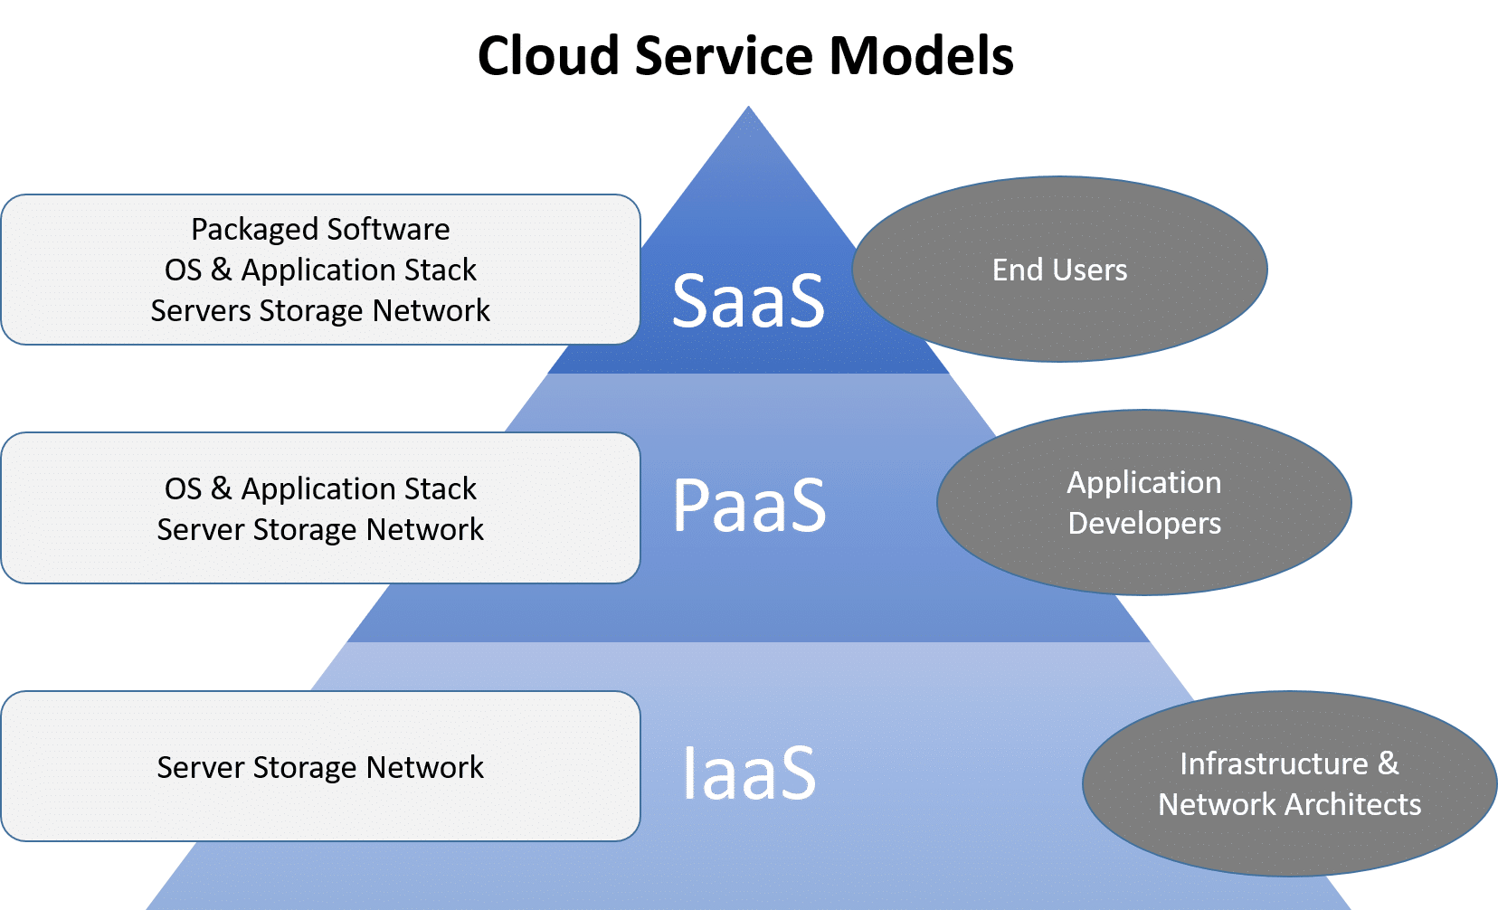
3 Models of Cloud Computing

Slide 6
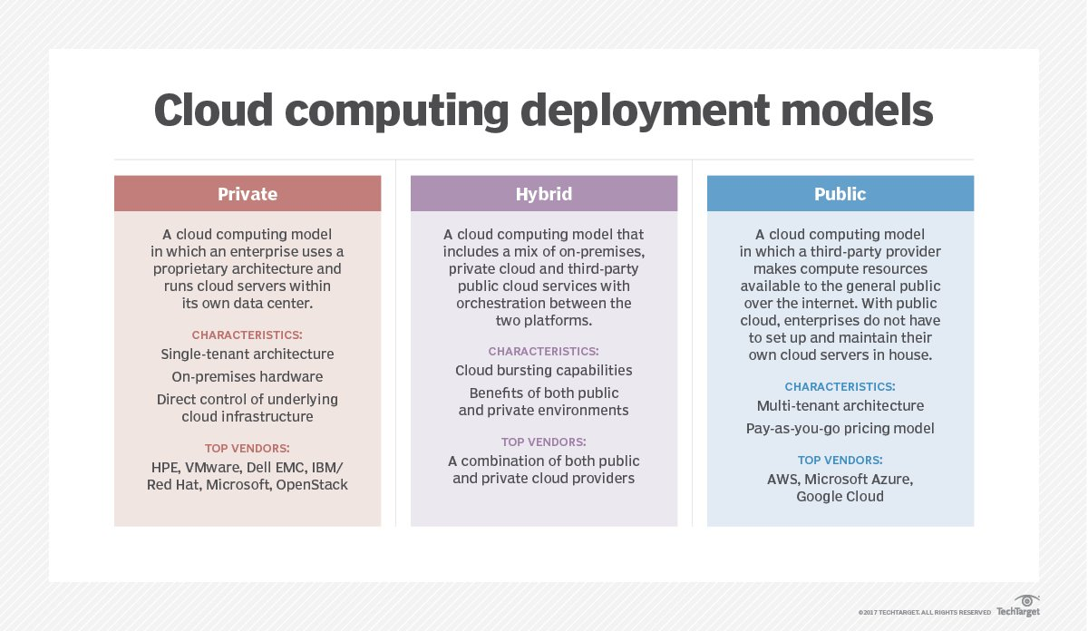
Cloud Computing Deployment Models

Slide 7
Private Cloud
Private cloud services are delivered from a business's data center to internal users.
With a private cloud, an organization builds and maintains its own underlying cloud infrastructure.
This model offers the versatility and convenience of the cloud, while preserving the management, control and security common to local data centers.
Internal users might or might not be billed for services through IT chargeback.
Common private cloud technologies and vendors include VMware and OpenStack.

Slide 8
Public Cloud
In the public cloud model, a third-party cloud service provider (CSP) delivers the cloud service over the internet.
Public cloud services are sold on demand, typically by the minute or hour, though long-term commitments are available for many services.
Customers only pay for the central processing unit cycles, storage or bandwidth they consume.
Leading public CSPs include AWS, Microsoft Azure, IBM and Google Cloud Platform (GCP), as well as IBM, Oracle and Tencent.

Slide 9
Hybrid Cloud
A hybrid cloud is a combination of public cloud services and an on-premises private cloud, with orchestration and automation between the two.
Companies can run mission-critical workloads or sensitive applications on the private cloud and use the public cloud to handle workload bursts or spikes in demand.
The goal of a hybrid cloud is to create a unified, automated, scalable environment that takes advantage of all that a public cloud infrastructure can provide, while still maintaining control over mission-critical data.

Slide 10
Google Cloud resources
Google Cloud consists of a set of physical assets, such as computers and hard disk drives, and virtual resources, such as virtual machines (VMs), that are contained in Google's data centers around the globe.
Each data center location is in a region.
Regions are available in Asia, Australia, Europe, North America, and South America.
Each region is a collection of zones, which are isolated from each other within the region.
Each zone is identified by a name that combines a letter identifier with the name of the region. For example, zone a in the East Asia region is named asia-east1-a.

Slide 11
Google Cloud resources
This distribution of resources provides several benefits, including redundancy in case of failure and reduced latency by locating resources closer to clients.
This distribution also introduces some rules about how resources can be used together.

Slide 12
Accessing resources through services
In cloud computing, what you might be used to thinking of as software and hardware products, become services.
These services provide access to the underlying resources.
The list of available Google Cloud services is long, and it keeps growing.
When you develop your website or application on Google Cloud, you mix and match these services into combinations that provide the infrastructure you need, and then add your code to enable the scenarios you want to build.

Slide 13
Global, Regional, and Zonal resources
Some resources can be accessed by any other resource, across regions and zones.
These global resources include preconfigured disk images, disk snapshots, and networks.
Some resources can be accessed only by resources that are located in the same region.
These regional resources include static external IP addresses.
Other resources can be accessed only by resources that are located in the same zone.
These zonal resources include VM instances, their types, and disks.

Slide 14
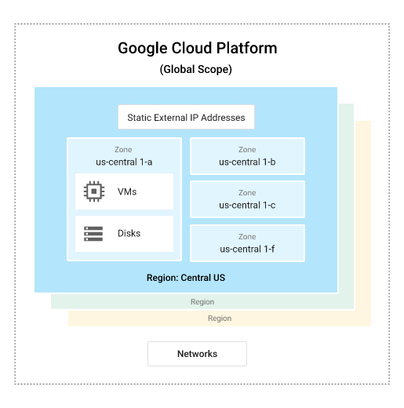
Global, Regional, and Zonal resources
The scope of an operation varies depending on what kind of resources you're working with.
For example, creating a network is a global operation because a network is a global resource, while reserving an IP address is a regional operation because the address is a regional resource.

Slide 15
Ways to interact with the services
Google Cloud console
Command-line interface
Client libraries

Slide 16
Geography and Regions

Slide 17
Geography and Regions
Google Cloud products are served from specific regional failure domains and are fully supported by Service Level Agreements to ensure you are designing your application architecture within the structure of Google Cloud.
Google Cloud infrastructure services are available in locations across North America, South America, Europe, Asia, and Australia.
These locations are divided into regions and zones.
You can choose where to locate your applications to meet your latency, availability, and durability requirements.

Slide 18
Regions and Zones
Regions are independent geographic areas that consist of zones.
Zones and regions are logical abstractions of underlying physical resources provided in one or more physical data centers.
These data centers may be owned by Google and listed on the Google Cloud locations page, or they may be leased from third-party data center providers.

Slide 19
Regions and Zones
A zone is a deployment area for Google Cloud resources within a region.
Zones should be considered a single failure domain within a region.
To deploy fault-tolerant applications with high availability and help protect against unexpected failures, deploy your applications across multiple zones in a region.
To protect against the loss of an entire region due to natural disaster, have a disaster recovery plan and know how to bring up your application in the unlikely event that your primary region is lost.
Google Cloud's services and resources can be zonal, regional, or managed by Google across multiple regions

Slide 20
Zonal Resources
Zonal resources operate within a single zone.
Zonal outages can affect some or all of the resources in that zone.
An example of a zonal resource is a Compute Engine virtual machine (VM) instance that resides within a specific zone.

Slide 21
Regional resources
Regional resources are resources that are redundantly deployed across multiple zones within a region,
For example App Engine applications, or regional managed instance groups.
This gives them higher availability relative to zonal resources.

Slide 22
Multiregional Resources
Multiple Google Cloud services are managed by Google to be redundant and distributed within and across regions.
These services optimize availability, performance, and resource efficiency.

Slide 23
Global services
Google Cloud has been designed to operate globally from the ground up and continually conducts maintenance and upgrades 24/7/365 without inconveniencing you.
Our global backbone provides tremendous flexibility for load-balancing and reduces end-user latency by having interconnects close to you.
Our global cloud management plane simplifies managing multi-region developments.

